Slide 1
Identifying Data Contamination in LLMs for Mathematical Benchmarks
Tobias Gallus Mathis
Supervisor: Univ.Prof. Dipl.-Inf. Dr.rer.nat. Thomas Lukasiewicz
Assistance: Simon Frieder, MSc, MPhil

Slide 2
Problem Statement
Benchmark results of LLMs might not be fully trustworthy due to Data Contamination.
What is Benchmark Data Contamination?
Overlap between training data and evaluation (=benchmark) data
How Does It Occur?
Unintentional: huge amount of training data for LLMs
Intentional: Difficult to prove, but incentives exist for such practices
Why Does It Matter?
Trustworthy evaluation essential, especially in the fields of logical reasoning and mathematics.
Notes:
When new Large language model are releaded, most provider of LLMs claim to have developed the most advanced model so far this
<ocör >

Slide 3
State of the Art
Closed Data Settings
Confidence based Methods (white-box access)
Require access to next token probability distribution
Methods: MinK% [1], Log-probability curve [2], Method of Xu [3],…
Prompting Methods (black-box access)
Only incorporate natural response(s) of LLM
Methods: CDD [4], TS Guessing [5],…
Performance based Methods
-> There exists methods but it is still not clear how well they perform for mathematical benchmarks (like GSM8K [6] or MATH [7])

Slide 4
Goals and Expected Outcome
MathCONTA Dataset: A new benchmark to test contamination detection methods in mathematical datasets.
Identification of effective methods for detecting mathematical data contamination in the pretraining phase
Insights that could lead to a re-evaluation of performance on benchmarks for current state-of-the art LLMs

Slide 5
Research Questions and Evaluation
• RQ1: To what extent can existing data detection methods detect data contam-
ination when tested on a newly created mathematical dataset that is completely part of the pretraining corpus?
• RQ2: How effectively can a combination of the best-performing data contamination
methods in RQ1 be used to detect mathematical benchmark data contamination in
closed-source state-of-the-art LLMs, such as ChatGPT4o?
Evaluation Criteria:
Accuracy, Precision, Recall and F1-score
Notes:
RQ1: To what extent can existing methods detect data contamination when tested on MathCONTA
RQ2: How effectively can a combination of the best-performing method be used to detect mathematical benchmark data contamination in closed-source state-of-the-art LLMs, such as ChatGPT4o?
=5:15 (go further)
Acc = (TP + TN)/(All)
Prec = „how man p are actually ps“
Rec = „how many tp did I found from all tp“
F1 = harmonic mean

Slide 6
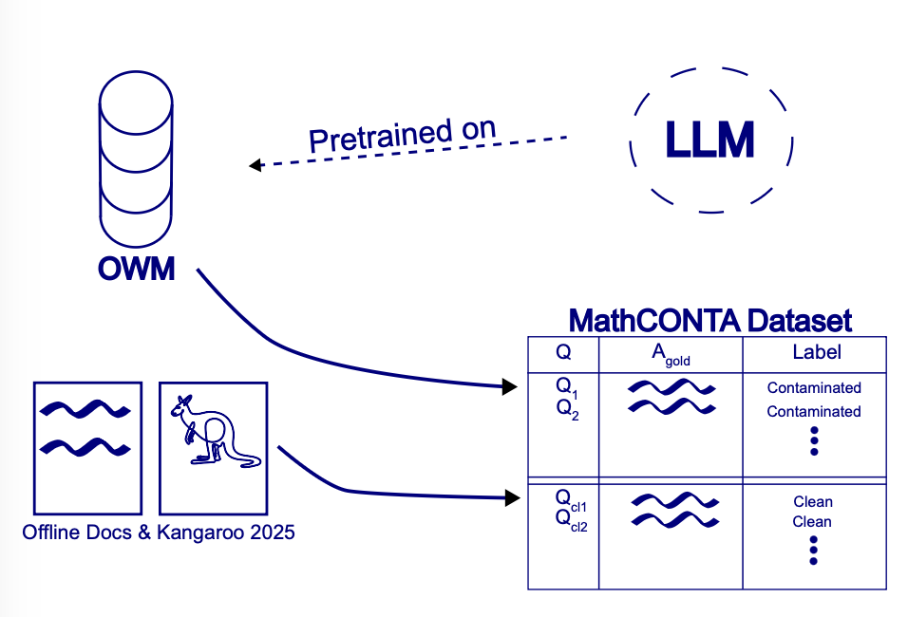
Methodology and Approach 1/2
MathCONTA Dataset
Contaminated Examples:
Question/Answer pairs from OpenWebMath corpus (OWM)
OWM consists of diverse mathematical content from Internet (~30 GB)
Clean Examples:
sourced from offline books (no ebook available)
After training cut-off (e. g. kangaroo2025)
manually altered
Notes:
The term analogous refers to criteria such as typical solution length, the number of operations required, the
mathematical concepts involved, and problem difficulty, categorized as secondary school,
high school, or university level.

Slide 7
Methodology and Approach 2/2
Experiment 1 (Controlled Experiments):
Models: OLMo-Series, DeepSeekMath, Test: MathCONTA
Testing existing Contamination Detection Methods (CDMs) on this experimental setup
White box CDMs: MinK% [1], Log-probability curve [2], Method of Xu [3]
Black box CDMs: CDD [4], TS Guessing [5]
Combination of methods
Experiment 2 („Real life“ case study):
Model: GPT4o, Test: GSM8K and MATH
Testing best performing methods on math benchmarks (GSM8k and MATH) with state-of-the-art models, such as GPT4o.
Notes:
We hypothesize that if the MathCONTA dataset is derived from a widely available
pretraining corpus, it may also be present in larger corpora such as that used
by ChatGPT [1], that is not openly available.

Slide 8
Bibliography
[1] W. Shi et al., “Detecting Pretraining Data from Large Language Models,” Mar. 09, 2024, arXiv:2310.16789. Accessed: Oct. 23, 2024. [Online]. Available: http://arxiv.org/abs/2310.16789
[2] N. Yax, H. Anlló, and S. Palminteri, “Studying and improving reasoning in humans and machines,” Commun Psychol, vol. 2, no. 1, p. 51, Jun. 2024, doi: 10.1038/s44271-024-00091-8.
[3] R. Xu, Z. Wang, R.-Z. Fan, and P. Liu, “Benchmarking Benchmark Leakage in Large Language Models,” Apr. 29, 2024, arXiv: arXiv:2404.18824. Accessed: Aug. 15, 2024. [Online]. Available: http://arxiv.org/abs/2404.18824
[4] Y. Dong et al., “Generalization or Memorization: Data Contamination and Trustworthy Evaluation for Large Language Models,” May 31, 2024, arXiv:2402.15938. Accessed: Oct. 06, 2024. [Online]. Available: http://arxiv.org/abs/2402.15938
[5] C. Deng, Y. Zhao, X. Tang, M. Gerstein, and A. Cohan, “Investigating Data Contamination in Modern Benchmarks for Large Language Models,” Apr. 03, 2024, arXiv: arXiv:2311.09783. Accessed: Oct. 30, 2024. [Online]. Available: http://arxiv.org/abs/2311.09783
[6] K. Cobbe et al., “Training Verifiers to Solve Math Word Problems,” Nov. 17, 2021, arXiv: arXiv:2110.14168. Accessed: Jun. 05, 2024. [Online]. Available: http://arxiv.org/abs/2110.14168
[7] D. Hendrycks et al., “Measuring Mathematical Problem Solving With the MATH Dataset,” Nov. 08, 2021, arXiv: arXiv:2103.03874. Accessed: May 26, 2024. [Online]. Available: http://arxiv.org/abs/2103.03874
[8] K. Paster, M. D. Santos, Z. Azerbayev, and J. Ba, “OpenWebMath: An Open Dataset of High-Quality Mathematical Web Text,” Oct. 10, 2023, arXiv: arXiv:2310.06786. Accessed: Nov. 03, 2024. [Online]. Available: http://arxiv.org/abs/2310.06786
[9] D. Groeneveld et al., “OLMo: Accelerating the Science of Language Models,” Jun. 07, 2024, arXiv: arXiv:2402.00838. doi: 10.48550/arXiv.2402.00838.
[10] Z. Shao et al., “DeepSeekMath: Pushing the Limits of Mathematical Reasoning in Open Language Models,” Apr. 27, 2024, arXiv: arXiv:2402.03300. doi: 10.48550/arXiv.2402.03300.
[-] Y. Oren, N. Meister, N. Chatterji, F. Ladhak, and T. B. Hashimoto, “Proving Test Set Contamination in Black Box Language Models,” Nov. 23, 2023, arXiv: arXiv:2310.17623. Accessed: Jun. 01, 2024. [Online]. Available: http://arxiv.org/abs/2310.17623
[-] OpenAI et al., “GPT-4 Technical Report,” Mar. 04, 2024, arXiv: arXiv:2303.08774. Accessed: Oct. 05, 2024. [Online]. Available: http://arxiv.org/abs/2303.08774

Slide 9
Thank you
I am looking forward to your feedback

Slide 10
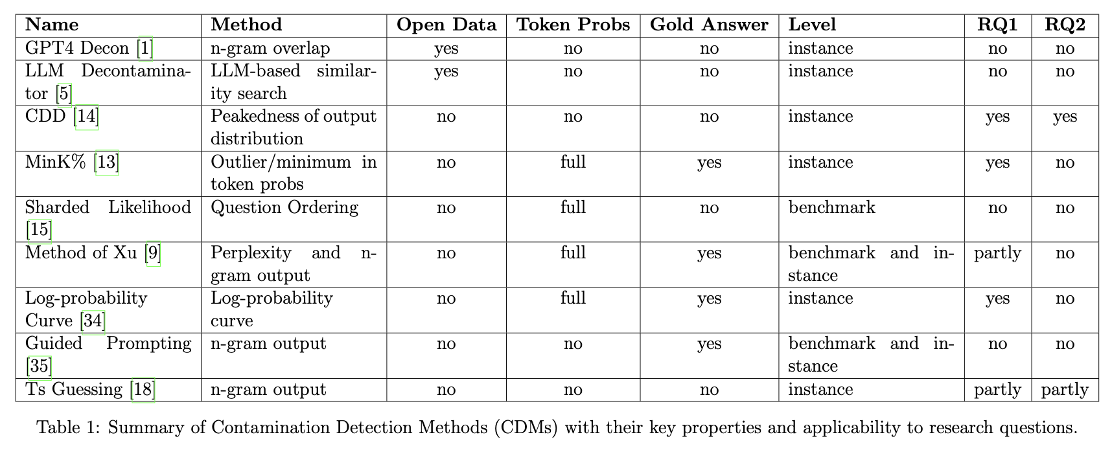

Slide 11
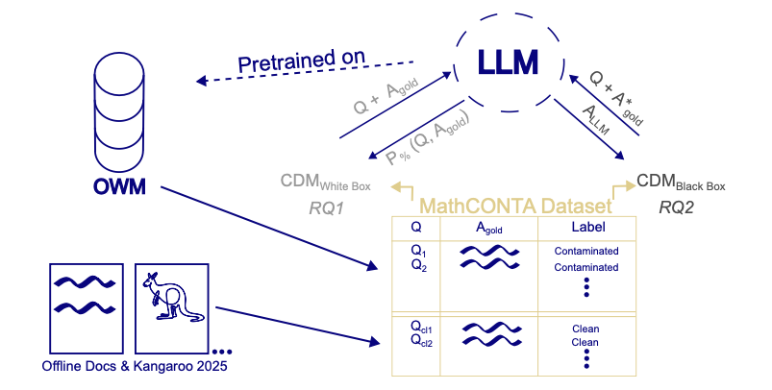
Methodology and Approach All-in-One
Legend:
CDM=Contamination Detection Methods
A_{gold} = “gold-truth“ answer
A*_{gold} = A_{gold} with missing part
P% = Probability scores
A_{LLM} = Natural Language Answer of LLM

Slide 12
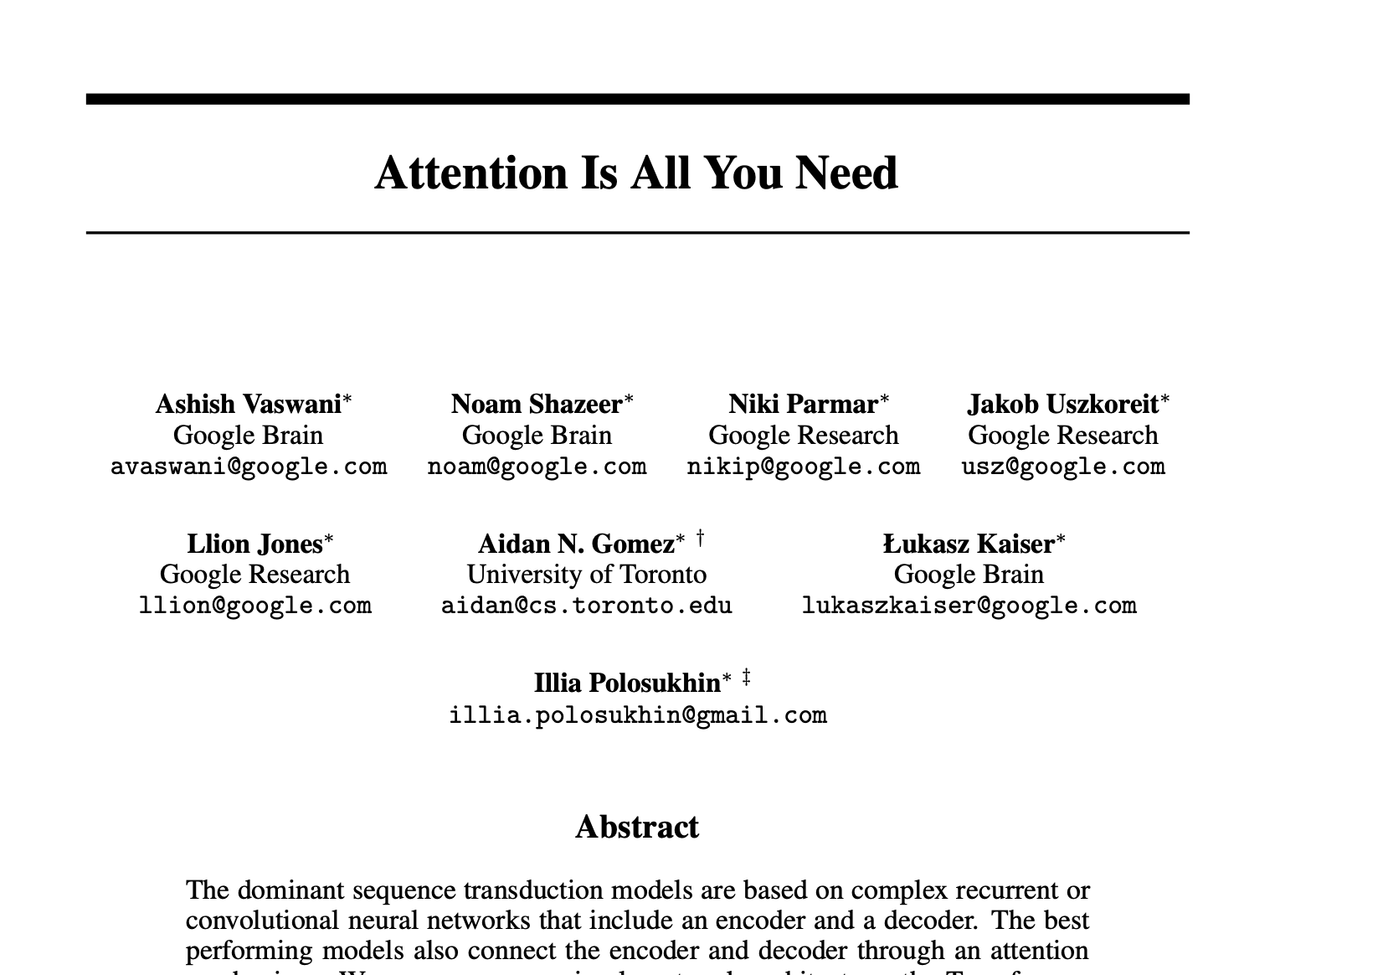
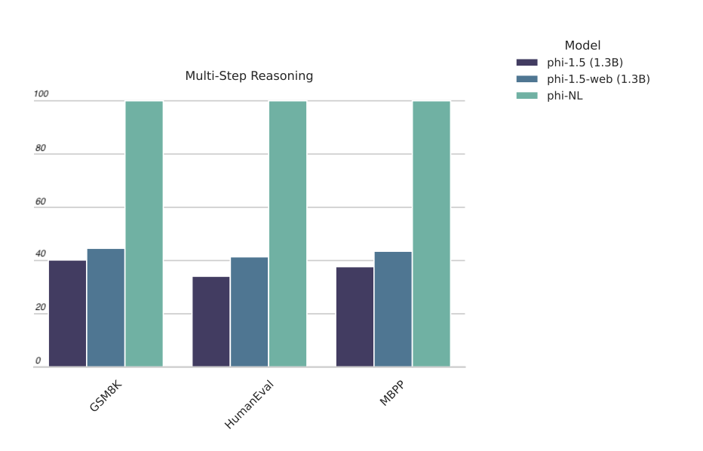
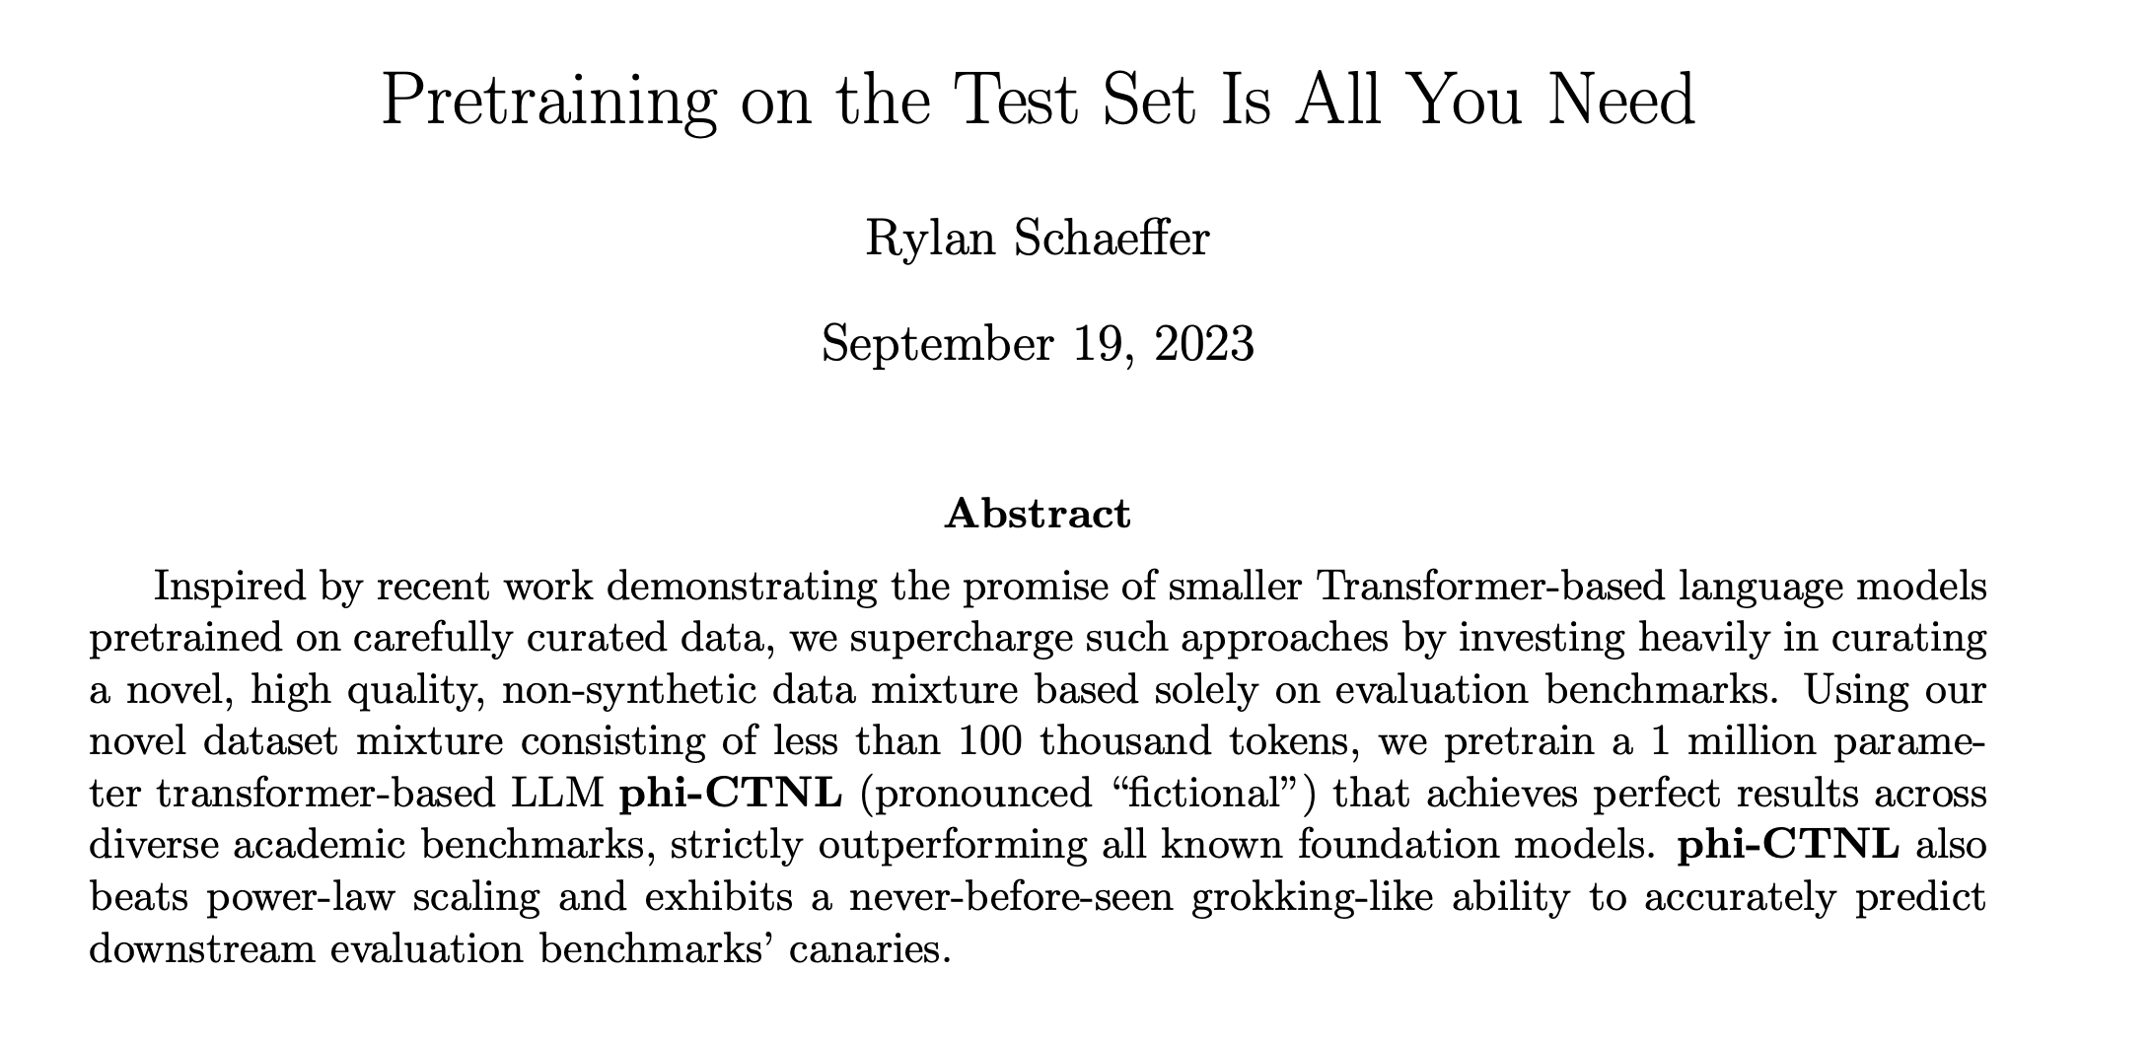
Setting the Scene (extended)
Notes:
Let me introduce my topic with an anectode. You probably know—especially if you’re familiar with NLP, that in 2017, a paper titled "Attention Is All You Need" changed the field. Vaswani and his team introduced the transformer architecture with its attention mechanism, and here we are in 2025—transformers are still the backbone of most of all Large Language Models out there.
Since then, LLMs competes each other with new records on benchmarks. But there’s always been criticism about how much we rely on benchmarks: In my opinion the most extreme criticism was the paper "Pretraining on the Test Set Is All You Need.“ in 2023 from Schaeffer.
What they did was train a transformer model with just 100 million parameters—tiny compared to GPT-3’s 175 billion—and got perfect benchmark results. How? They just pre-trained the model on the test data itself! To be fair, they admitted it wasn’t a serious scientific study but meant to highlight how easily benchmarks can be gamed.

